Slide 1



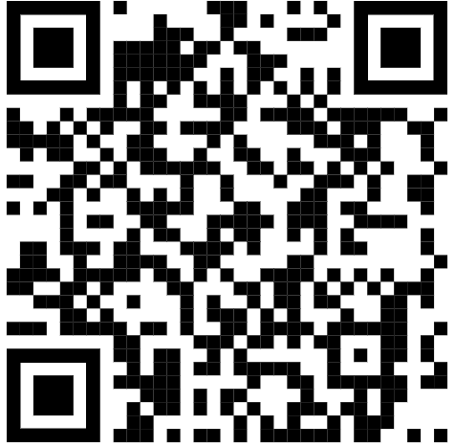

Course Outline
Welcome
Grading Policy
to
Assessments (60%)
SAVVAS Essays (Test)
Creative Culminating Independent Reading Projects (Tests)
Short Written Responses(Quiz)
Quizzes or other online assessments (Quiz)
SAVVAS Unit Assessments (one selection= Quiz, multiple selections= test)
Classwork (35%)
Interactive Notebook Activities
Graphic Organizer work
SAVVAS: Annotations of texts, Analysis Questions, Focus Skills assignments in the textbook.
Most Partner/Group work assigned in class.
Homework (5%)
Independent Reading Responses
SAVVAS reading completion
Completion of unfinished classwork.
Parent/Guardian Signed Grade Report print outs
Marking Period 1:
Getting Started Activities
Savvas, My Perspectives Unit 1 - Survival
Completion of Whole Class, Peer Group, Independent Learning, Reflect and Respond, and two Argument Essays.
Novel Study: The Joy Luck Club by Amy Tan
Marking Period 2:
Savvas, My Perspectives Unit 2 -
Promise and Progress
Completion of Whole Class, Peer Group, Independent Learning, Reflect and Respond, Informative Presentation, and an Informative Essay.
Novel Study: To Kill a Mockingbird by Harper Lee
Marking Period 3:
Savvas, My Perspectives Unit 3 -
Crazy, Stupid, Love
Completion of Whole Class, Peer Group, Independent Learning, Reflect and Respond, and two Argument Essays.
Novel Study: Great Expectations by Charles Dickens
Marking Period 4:
Savvas, My Perspectives Unit 4 -
Journeys of Transformation
Completion of Whole Class, Peer Group, Independent Learning, Reflect and Respond, and two Explanatory Essays.
Novel Study: The Awakening by Kate Chopin
ELA Honors 1
Ms. Sherman
Room A217
Periods
^ Email me
carrsherman@paps.net

Slide 2


Phone Policy
Food Policy
Late Work?
Phones are NOT allowed to be used as per the Perth Amboy High school policy.
Phones must be placed in the phone holders in the classroom.
Phones may be used IF. . .
You have spoken with me for a special allowance (EX. you need to have your phone because you forgot your computer at home.)
You use an app for medical reasons (and an email from guidance has been sent to notify teachers)
I believe that, ultimately, the learning is more important than the due date. That said, late-work is allowed in upon the following conditions:
Excused absences- you should make up the work by following Friday.
Unexcused absences- come see me in my classroom after school, between 3:01- 3:45 PM
Food and Drink allowances are limited in the school building.
You are permitted to bring a water bottle into the classroom.
This is to maintain a safe and focused learning environment.
You may be rewarded at the end of a Marking Period with a food related prize only after allergies have been reviewed and permission has been granted by parents.( I will email or text them)
The truth is, I have many students.
I can only maintain my effectiveness through staying organized.
If you see me after school I can help you catch up, keep up, and make up missing work.

